Slide 1


Making Data Count
& Statistical Process Control (SPC)
Bitesize Intro
Quality Improvement Week | 19-23 October 2020
Notes:
Welcome to this bitesize session on the NHS Improvement Making Data Count Initiative and brief introduction to Statistical Process Control charts.
My name is Deborah Cundey, and I’m currently a Service Development Manager in clinical operations, with responsibility for the production and presentation of various performance and quality information across the Trust.

Slide 2

Session Plan
Making Data Count NHSI methodology
Information and the way we present it
Variation
What is an SPC chart?
Benefits of SPC
Tools to create SPC charts
Tell me more!
Notes:
In this session I am going to:
Introduce Making Data Count NHSI methodology
Ask us to think about
Information and the way we present it, how we are used to seeing data; analysing it and making decisions based on it
We will look at he theory behind variation – and understand common cause and special cause
Then have a look at what an SPC chart actually is, look at special cause variation and SPC rules and how we can use SPC for assurance
We will consider the benefits of SPC, share a little bit of information on how to create SC charts yourselves, and finally point you in the direction of some great resources to go away and explore more.

Slide 3

Is information important?
High quality information will empower the health and social care sector in identifying where new care is needed to meet the needs of local populations.
Using data, we can determine what care is working well and what needs to be improved, allowing patients, clinicians and commissioners to compare the quality and efficiency of care in different parts of the country
Dr Geraint Lewis
Chief Data Officer
NHS England
Notes:
Information has been described as the lifeblood of the NHS…a vital asset for the clinical management of individual patients and the efficient management of services.
In 20?? Dr Geraint Lewis, Chief Data Officer for NHS England said:
“High quality information will empower the health and social care sector in identifying where new care is needed to meet the needs of local populations. Using data, we can determine what care is working well and what needs to be improved, allowing patients, clinicians and commissioners to compare the quality and efficiency of care in different parts of the country.”
We need to really understand, through evidence, our services, teams, patients and so on, in order to be able to assess how we are doing; what we need to do, what could improve and to identify where we are doing something well.
Too often we jump to conclusions based on hearsay, assumptions or anecdotes
I am sure you can think of an example of when you’ve been asked to make a change or suggested a change in practice as a result of an anecdote or hunch?

Slide 4
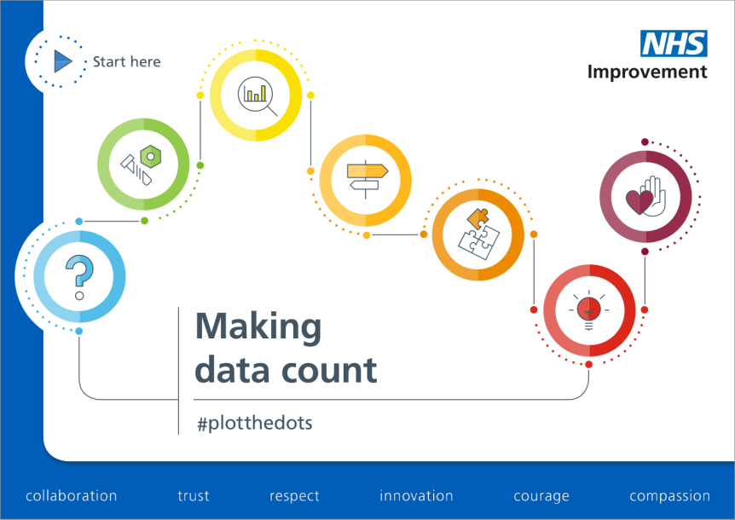
Making Data Count
Notes:
Making data count is a guide that was published in 2017/18, followed by a second guide last year. The guides are designed to support people working in the NHS to make the best use of data to inform judgements and decisions for action.
They are aimed at everyone – the people responsible for analysing, interpreting and presenting data to others and the decision-makers (for example, managers and clinicians) who need data to answer questions. They describe why we should be presenting and using data more effectively and how to do it. They are full of real life case studies and exercises, illustrating the different perspectives that clinicians, managers and analysts bring and show how closer working between these groups can add great value.
And, in really simple terms, Making Data Count is about us moving away from RAG and 2 point comparisons like this:
CLICK
And presenting data in a more useful way.

Slide 5
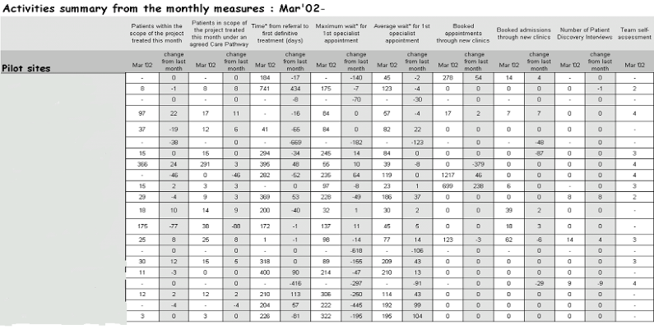

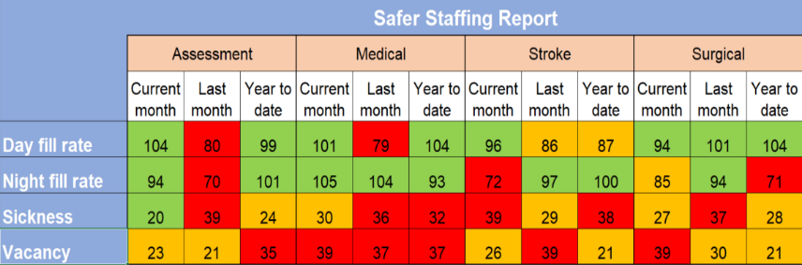

Two point comparison & RAG
Notes:
So what’s wrong with 2 point comparison? Brucie has the answer. Always higher or lower. (Or the same). But higher than last month is not a trend, it’s just not the same as last month!
Here are some examples of RAG and month on month comparison data – taken from real Trust Board and performance reports, including our own. I’m guessing they look familiar to you…
1 We often see data like this – people often react by circling numbers and little else
2 And most board papers contain data that looks like this
3 A sea of green – everything must be fine with these indicators as they are all green. If this were in a 70 page board report – how long would you spend looking at this?

Slide 6
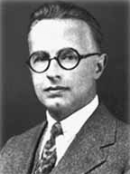
SPC – A Different Perspective
In the 1920s, Walter A Shewhart, an American physicist, was tasked with improving the quality of telephones in Bell Laboratories. His efforts played a key role in significantly improving the quality of manufactured products over subsequent decades. As part of his work, Shewhart developed a theory of variation which forms the basis of something called SPC – statistical process control.
This theory categorises variation into expected, or common cause and unusual, or special cause.
Notes:
Introducing Walter A Shewart, who developed a theory of variation in the 1920s.
In the real world everything varies: how long it takes to travel to work, how long it takes to record a patient’s blood pressure, how many patients need a home visit?
Think about your journey to work: does it take exactly the same time every day or does it vary? It will be slower if the ticket machine is broken, there is a queue for the lift; quicker if there’s no traffic on the road because there’s a global pandemic…
… This is an example of what is called ‘common cause’ variation; variation that is outside your control. You can’t say exactly how long your journey to work will take on any particular day, but you can give a range for what is expected.
In turn, this guides what type of action is required – which in some cases may be none. All too often, we overreact to variation which is normal – we waste lots of time investigating a ‘deterioration’ which SPC tells us is normal.

Slide 7
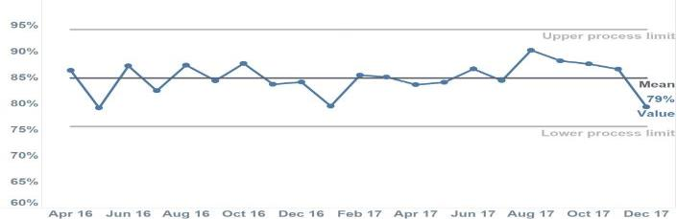
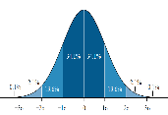
The anatomy of an SPC Chart
Time series line chart with 3 reference lines
≈ 99% of data
15 plus data points for a robust analysis
Notes:
A SPC chart is a time series graph, a basic run chart with the addition of 3 lines!
So, those three lines.
Firstly a mean or average line in the middle.
Then two lines called control limits or process limits. An upper and a lower limit. 99% of data points will fall within these limits. The control limits are set by the values and represent common cause variation as you would expect to see in any kind of process.
You do need a minimum number of data points to create a robust SPC chart and at least 15 is recommended.

Slide 8
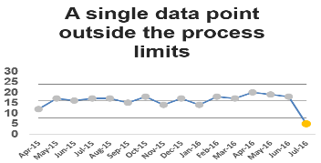
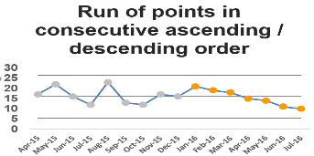
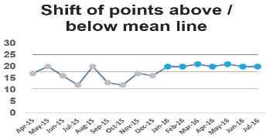
SPC Rules
Notes:
There are SPC rules
Most people don’t need to understand the detail of these rules. They are based on probability. There are 8 rules – the simplest ones are:
1 - A single point outside the control limits
Whenever a data point falls outside a process limit (upper or lower) something unexpected has happened because we know that 99% of data should fall within the process limits.
2 - A run of values above or below the average (mean) line represents a trend that should not result from natural variation in the system.
The key consideration in this rule is how many data points you decide represents special cause variation.
Most people use between seven and nine points. You should decide the number based on how frequently
you want to ask questions of your system or process. The lower the number the greater the chance special
cause variation will be identified. If data is provided monthly, you might want to use six points as six months
is long enough to see any improvement. But if your data is provided daily, you may choose a higher number
to avoid too frequent interventions. What you can be sure of is that a run of fewer than six points is
insufficient as this can occur randomly and could result in you tampering with your system unnecessarily.
3 - A run of six or more values showing continuous increase or decrease is a sign that something unusual is happening in the system.
It does not matter where the run starts or finishes in relation to the mean line and it is widely
accepted that six data points are sufficient to represent special cause variation. How many times have
you heard people talking about a trend when this trend consists of two or three data points? For
robust interpretation, a trend needs to have at least six points.
If one of the SPC rules is triggered, this is called special cause variation and it means that an unusual pattern in the data has occurred which should be investigated.

Slide 9

7 points?
In a random system with 50% chance of improvement or decline..
  A trend of 2 has the probability of 25% occurrence (one in four)
  A trend of 4 has the probability of 6.25% occurrence (one in sixteen)
  A trend of 6 has the probability of 1.56% occurrence (one in sixty-four)
  A trend of 7 has the probability of 0.8% occurrence (one in one hundred and twenty-eight)
Notes:
So why do we choose to use 7 points to highlight special cause trend up or down?
It’s all to do with probability (which stretches my brain a little bit too much) – but put simply, the chance of the system randomly improving or declining is one in 128. So it’s very unlikely to occur unless something is actually happening.

Slide 10


Playing the Detective
Notes:
And if there is special cause, it is an indication to investigate, have a look and see if you can identify what has made the system behave in this way. Examples of this can be when we focus on the achievement of a particular goal and make improvements – for example recently we have been seeking to improve our compliance with supervision and recording of supervision, and that has paid off. If you were monitoring the number of assessments undertaken within a service, and your SPC identified special cause decline, it could be due to staff absence or vacancies?

Slide 11
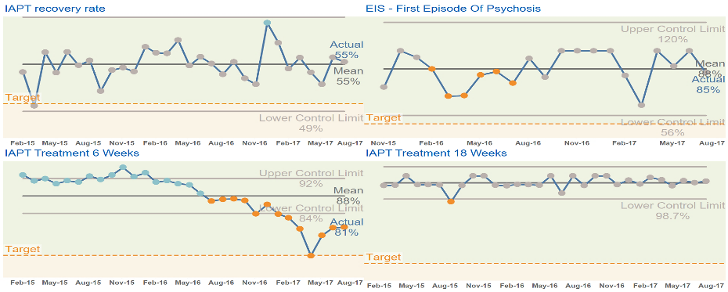
A Different Perspective
Notes:
All too often, we overreact to variation which is normal – we waste lots of time investigating a ‘deterioration’ which SPC tells us is normal.
Let’s take a look at some the information we looked at earlier…
This is the same data as the previous table of numbers. The time series is extended. These are SPC or control charts. By using SPC charts, we see a different picture. The green colour coding has masked deteriorating performance.

Slide 12
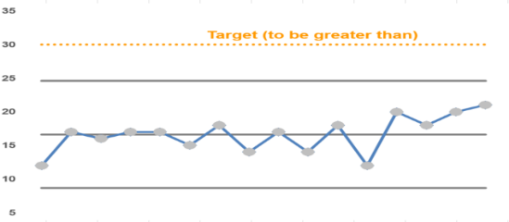
In control, but…
Redesign the system
Notes:
If a system is ‘in control’ it doesn’t necessarily mean that you don’t need to take action.
A system may be in control but not capable of delivering the required standard or target
In this case, the system needs to be redesigned.
Or a system could be ‘in control’ but the range or level of variation is unacceptable to you.
An example of this might be referrals into a team – you may be targeted, funded and staffed to deal with a certain number of referrals per day, week or month.
You could see common cause variation where the range in referrals makes it very difficult to manage in your current model. So SPC can help us in this way to look at what system we need to put in place to manage the level of variation.

Slide 13

Why should we use SPC charts?
SPC alerts us to a situation that may be deteriorating
SPC shows us if a situation is improving
SPC shows us how capable a system is of delivering a standard or target
SPC shows us if a process that we depend on is reliable and in control.
Notes:
SPC provides statistical rigour to help us understand when something unusual is happening in the system – for good or bad. Without these it’s left to interpretation, with one person able to say something is wrong, another one saying it’s not.

Slide 14
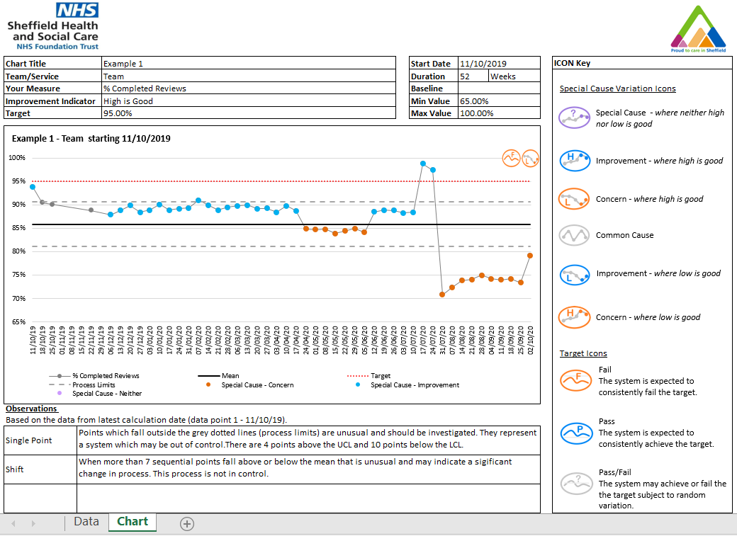
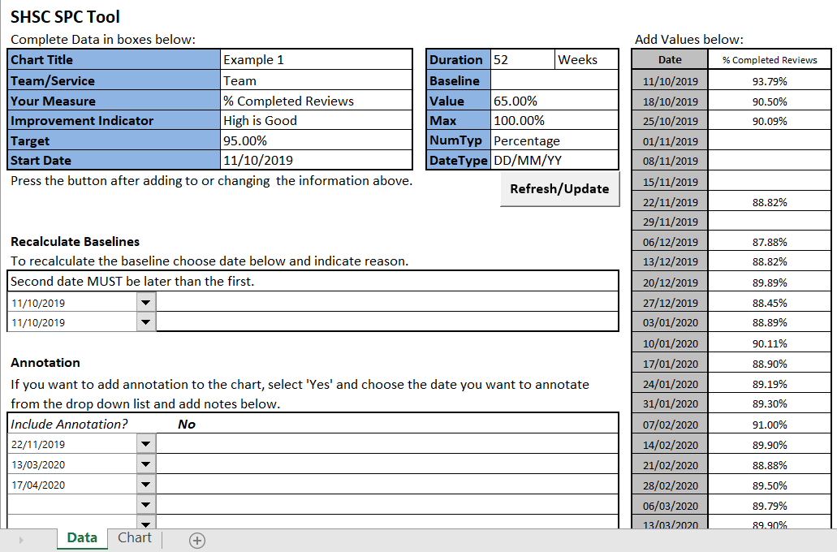
Notes:
We have created a version of the NHSI SPC chart tool to use within SHSC. Our aim is to use this tool consistently across the organisation when we are considering time series data.
Here are some examples of the information we are providing using this tool.
Covid Daily Dashboard – Staff not working daily chart
Referrals to IAPT- Weekly
Adult Acute Inpatient Admissions – Monthly
We currently have a template in Excel (v14) , and are looking to create in other software in the future. To have a look at our current tool and start to use it, please get in touch with me:
Deborah.Cundey@shsc.nhs.uk

Slide 15
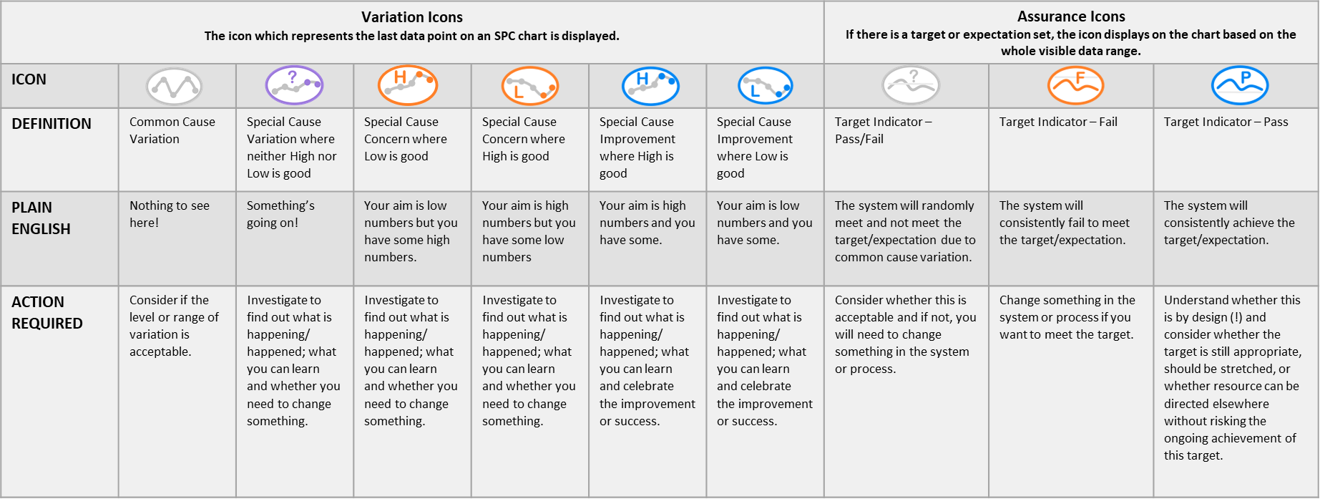
SPC Icons

Slide 16

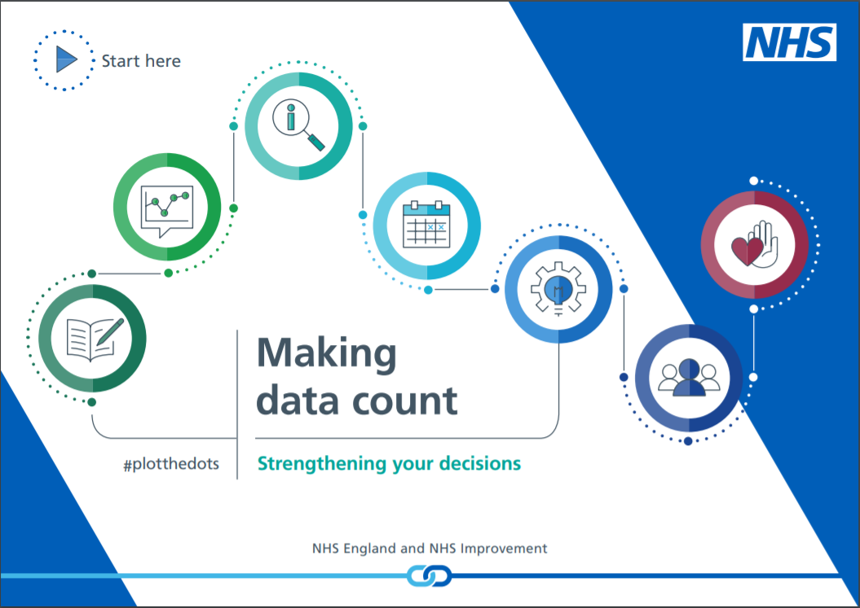




Making Data Count Resources & Links
https://improvement.nhs.uk/resources/making-data-count/
@NHSImprovement
@samriley
Notes:
So, finally I will leave you with some of the links to go away and find out more, and encourage you to think about whether there are things that you can change in your practice to help SHSC on our SPC journey – that might be as simple as challenging a decision or statement if you can see it’s based on meaningless information, or as complex as creating the code for an SHSC SPC tool in a new piece of software. We all have a part to play.
Thanks for listening! Please get in touch with me if you want to find out more or have any suggestions.

Slide 17
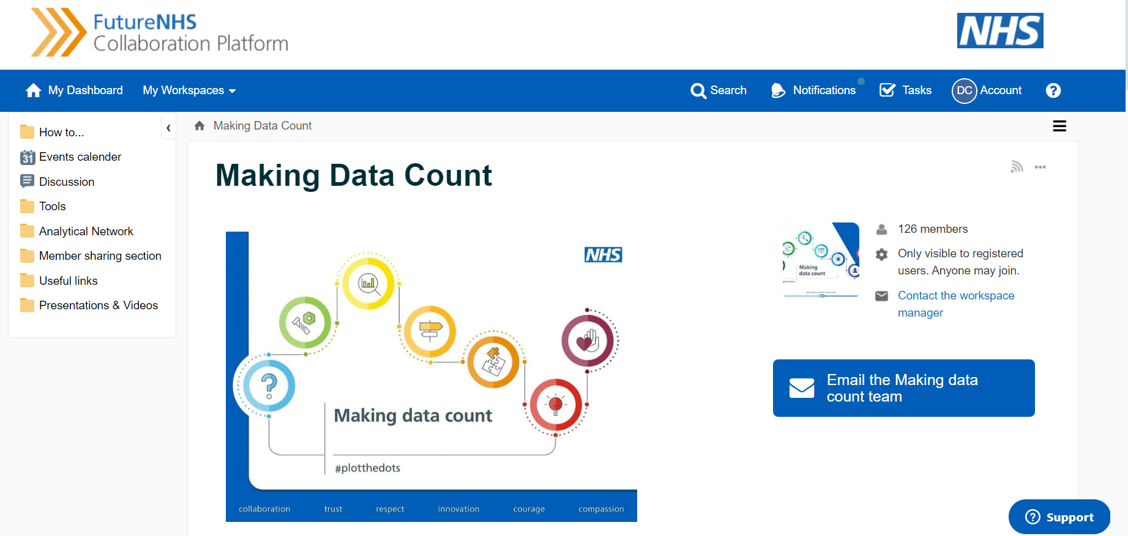
Making Data Count Resources & Links
FutureNHS collaboration platform - register to be a member
Making Data Count Workspace – public group, request to join
Notes:
Thanks for listening! Please get in touch with me if you want to find out more or have any suggestions.

Slide 18


Contact
Deb Cundey
deborah.cundey@shsc.nhs.uk
Deborah Cundey
Deborah Cundey

